Slide 1



LOB CUSKIT LAUNCH DASHBOARD
IMPACTED BY COVID-19
CHIN WOOI LING

Slide 2
AGENDA
Project Background
Data Exploration
Prediction Model
Data Visualization
Conclusion

Slide 3


Slide 4


Slide 5
Data Visualization
Predictive Modeling
Featured Engineering
Data Exploration
Outlier Handling
Data Cleaning
Drop rows with “NA”
Remove low variance columns
Define categorical & numerical columns
Data Mining
Covid-19 Data Analysis
LOB Cuskit Launch
LOB Cuskit Revenue
Business Problem Understanding

Slide 6
Data exploration
Covid-19 Analysis
Cuskit SKU Launch
Cuskit SKU Launch
Covid-19 Data
(refreshed daily)
Cuskit
Covid-19 Data
(refreshed daily)

Slide 7
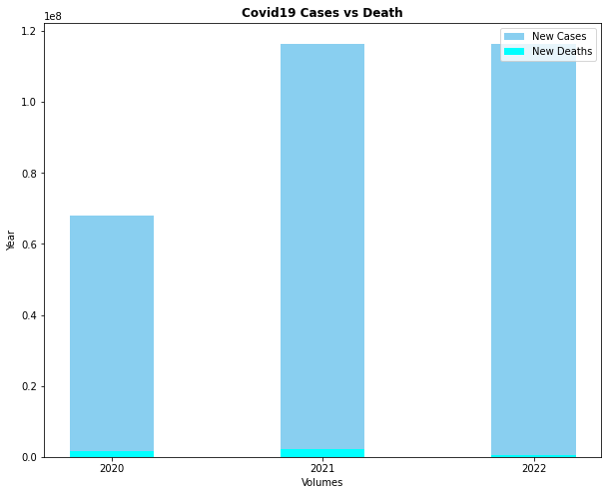
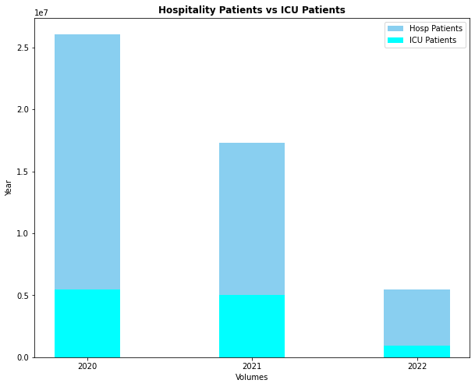
Covid-19 Analysis

Slide 8


Slide 9


Slide 10
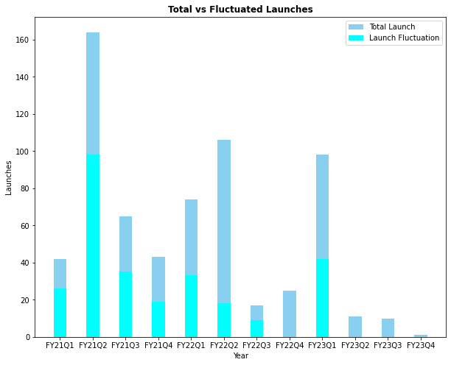
TOTAL
VS FLUCTUATED LAUNCHES

Slide 11
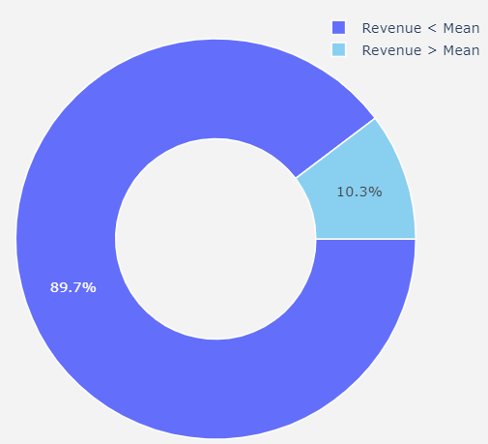
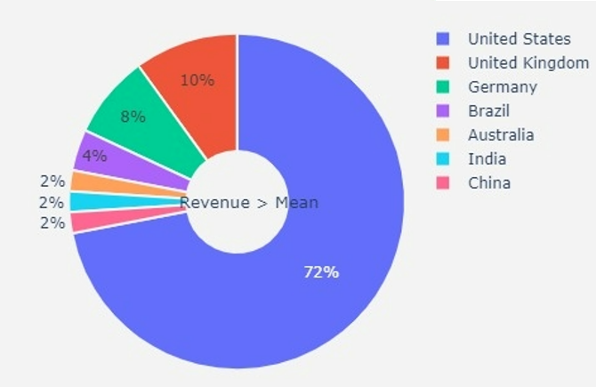
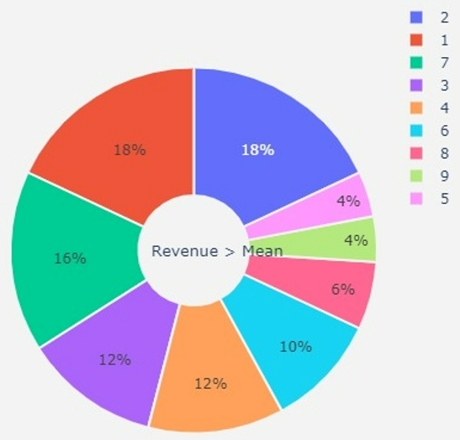
89.7% < Avg Revenue
72% Revenue generated from US
18% Revenue generated from newly created SKU

Slide 12
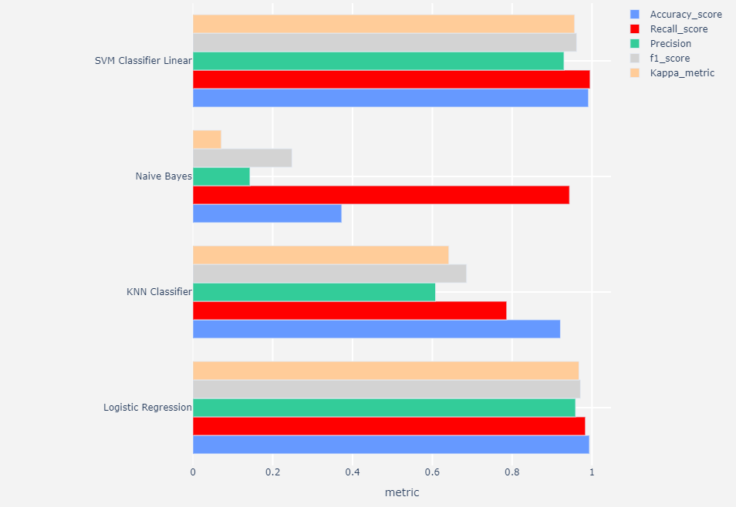
Model’s Performance

